Slide 1
Organisational Behaviour
Topic: Power
Dr. C. Vijaya Banu
Associate Professor , School of Management
SASTRA Deemed University, Thanjavur – 613 401
vijayabanu@mba.sastra.edu

Slide 2
How do you perceive power?
Power
Dark and gloomy?
Bright and cheery?

Slide 3
Power
Power: ability to get something done the way a person wants it done
Includes the ability to gather physical and human resources and put them to work to reach a goal
Essential to leadership and management functions
More than dominance: a capacity to get something done in an organization
Central feature of political behavior
Unavoidable presence in organizations
Facets of power
Potential power: one party perceives another party as having power and the ability to use it
Actual power: the presence and use of power
Potential for power: person or group has control of resources from which to build power

Slide 4
Power
Power relationships: moments of social interaction where power manifests itself
Dimensions of power relationships
Relational: social interaction between people and groups
Dependence
Reliance of one party on another party
High power when valued results not available elsewhere
Sanctioning: use of rewards or penalties
Power and authority
Different concepts although a person can have both
Authority usually flows from a person’s position in an organization
Power can accrue to people at any level

Slide 5
Power
Power flows
Reporting relationships
Lateral relationships
Cross-functional
relationships

Slide 6
Power dynamics
Power dynamics
Dynamic not static; rises and falls for people and groups
Shifts in environment can change power of person or group
Marketing: successful product--power goes up; lose market share--power goes down
Technology: as it increases in importance, people who know it become more powerful. The opposite happens as importance of technology drops

Slide 7
Bases of Power
Bases of power: aspects of formal management position and personal characteristics
Organizational bases of power: sources of power in formal management position
Personal bases of power: sources of power in a manager’s personal characteristics
Accumulate to a total power base
Organizational bases of power
Legitimate power- you derive from your formal position or office held in the organization's hierarchy of authority
Derives from position
Decision authority
Reward power- is rewarding individuals for compliance with organisational norms. This may be done through giving bonuses, raises, a promotion, extra time off from work, etc. For example, the supervisor who provides employees comp time when they meet an objective she sets for a project.
Tie positive results to a person’s behavior- provide reward
Organization’s reward system and policies

Slide 8
Bases of Power
Organizational bases of power (cont.)
Coercive power-is conveyed through fear of losing one's job, being demoted, receiving a poor performance review, having prime projects taken away, etc. This power is obtained through threatening others.
Tie negative results to a person’s behavior
Organization’s reward system and policies
Information power
Information control
Information distribution
-Formal Power
Is established by an individual’s position in an organization; conveys the ability to threaten or reward, from formal authority, or from control of information

Slide 9
Bases of Power
Organizational bases of power
All management positions have some organizational basis of power
Minimally have legitimate power
Reward and coercive power depend on organizational policies about rewards and sanctions
Assume the power in the position

Slide 10
Bases of Power
Personal bases of power
Referent power: positive feelings about the leader. Related to charisma
Expert power: technical knowledge and expertise
Flow from the attributes and qualities of the person
Strongly affected by attribution processes

Slide 11
Power Tactics
Power Tactics
Ways in which individuals translate power bases into specific actions
Influence Tactics
Legitimacy
Rational persuasion
Inspirational appeals
Consultation
Exchange
Personal appeals
Ingratiation (psychological)
Pressure
Coalitions

Slide 12
Preferred Power Tactics by Influence Direction
Upward Influence Downward Influence Lateral Influence
Rational persuasion Rational persuasion Rational persuasion Inspirational appeals Consultation Pressure Ingratiation Consultation Exchange Ingratiation Legitimacy Exchange Personal appeals Legitimacy Coalitions

Slide 13
Factors Influencing the Choice and Effectiveness of Power Tactics
How the request is perceived
Is the request consistent with the target’s values?
The culture of the organization
Culture affects user’s choice of tactic
Country-specific cultural factors
Local values favor certain tactics over others
Sequencing of tactics
Softer to harder tactics work best
Skillful use of a tactic
Relative power of the tactic user
Some tactics work better when applied downward or upward
The type of request attaching to the tactic
Is the request legitimate?

Slide 14
Power and Dependence
Person B’s counterpower over Person A
Person
A
Person
B
Person
B’s Goals
Person A’s power over Person B

Slide 15
Model of Power in Organizations
Sources
Of Power
Power
over Others
Legitimate
Reward
Coercive
Expert
Referent
Contingencies
Of Power

Slide 16
Information and Power
Control over information flow
Based on legitimate power
Relates to formal communication network
Common in centralized structures (wheel pattern)
Coping with uncertainty
Those who know how to cope with organizational uncertainties gain power
Prevention
Forecasting
Absorption

Slide 17
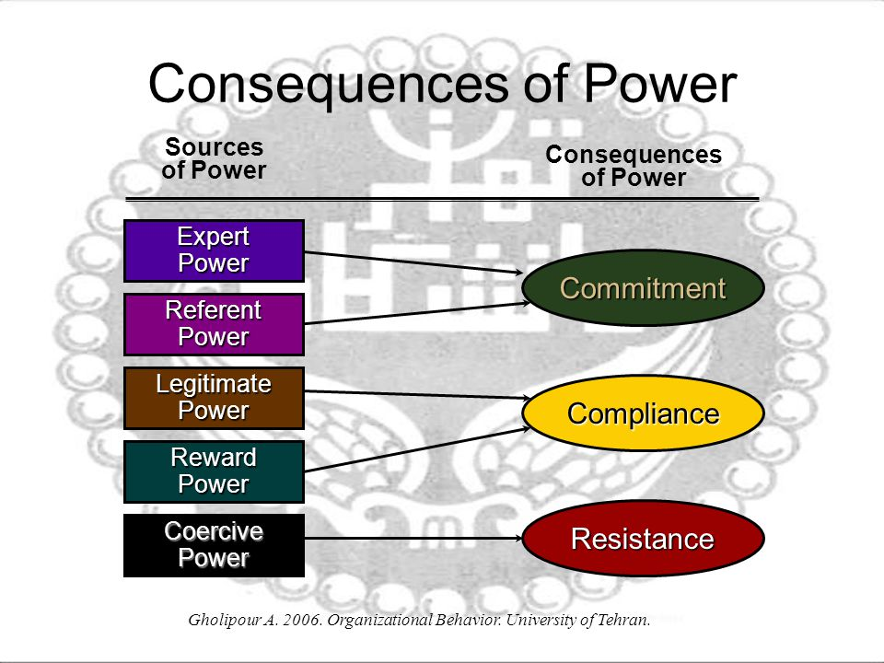

Slide 18
Organisational Behaviour
Topic: Politics
Dr. C. Vijaya Banu
Professor , School of Management
SASTRA Deemed University, Thanjavur – 613 401
vijayabanu@mba.sastra.edu

Slide 19
Organizational Politics
Attempts to influence others using discretionary behaviors to promote personal objectives
Discretionary behaviors -- neither explicitly prescribed nor prohibited
Politics may be good or bad for the organization

Slide 20
Types of Organizational Politics
Managing
impressions
Attacking and
blaming
Types of
Organizational
Politics
Creating
obligations
Controlling
information
Cultivating
networks
Forming coalitions

Slide 21
Conditions for Organizational Politics
Personal
Characteristics
Scarce
Resources
Conditions
Supporting
Organizational
Politics
Tolerance of
Politics
Complex and
Ambiguous
Decisions

Slide 22
Controlling Political Behavior
Provide
Sufficient
Resources
Remove
Political Norms
Introduce
Clear Rules
Hire
Low-Politics
Employees
Free Flowing
Information
Increase
Opportunities
for Dialogue
Manage Change
Effectively
Peer Pressure
Against Politics

Slide 23
Persuasive Communication
Communicator
Characteristics
• Expert
• Credibility
• Attractive
Communication Medium
Audience
Characteristics
• Self-esteem
• Inoculated
Message
Content
• Present all sides
• Few arguments
• Emotional appeals
• Inoculation effect

Slide 24
Politics Is in the Eye of the Beholder
“Political” Label “Effective Management” Label
1. Blaming others vs. Fixing responsibility
2. “Kissing up” vs. Developing working relationships
3. Apple polishing vs. Demonstrating loyalty
4. Passing the buck vs. Delegating authority
5. Covering your rear vs. Documenting decisions
6. Creating conflict vs. Encouraging change and innovation
7. Forming coalitions vs. Facilitating teamwork
8. Whistle blowing vs. Improving efficiency
9. Scheming vs. Planning ahead
10. Overachieving vs. Competent and capable
11. Ambitious vs. Career-minded
12. Opportunistic vs. Astute
13. Cunning vs. Practical-minded
14. Arrogant vs. Confident
15. Perfectionist vs. Attentive to detail
Source: Based on T. C. Krell, M. E. Mendenhall, and J. Sendry, “Doing Research in the Conceptual Morass of Organizational Politics,” paper presented at the Western Academy of Management Conference, Hollywood, CA, April 1987.
E X H I B I T 13–3

Slide 25
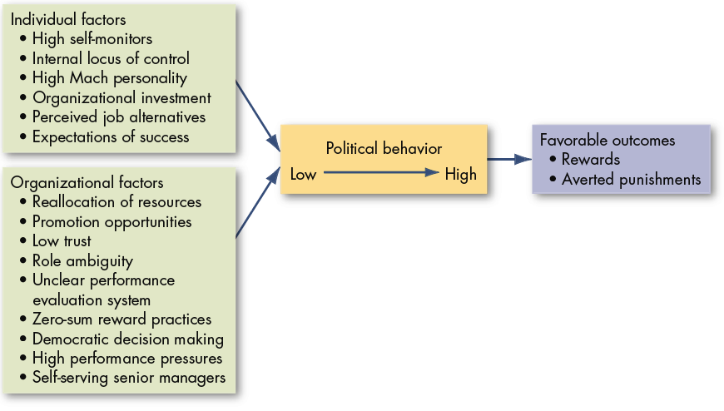
Factors That Influence Political Behaviors
E X H I B I T 14-4

Slide 26
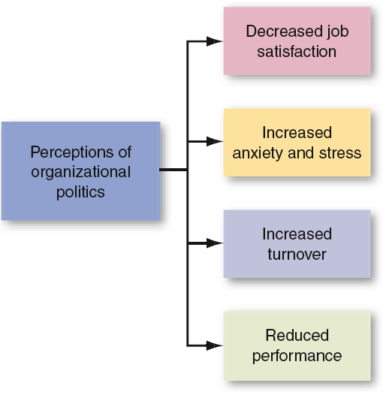
Employee Responses to Organizational Politics
E X H I B I T 14-5

Slide 27
Defensive Behaviors
Avoiding Action:
Overconforming
Buck passing
Playing dumb
Stretching
Stalling
Avoiding Blame:
Buffing
Playing safe
Justifying
Scapegoating
Misrepresenting
Avoiding Change:
Prevention
Self-protection
E X H I B I T 14–6

Slide 28
Impression Management (IM)
Impression Management
The process by which individuals attempt to control the impression others form of them.
IM Techniques:
Conformity
Excuses
Apologies
Self-Promotion
Flattery
Favors
Association
Source: Based on B. R. Schlenker, Impression Management (Monterey, CA: Brooks/Cole, 1980); W. L. Gardner and M. J. Martinko, “Impression Management in Organizations,” Journal of Management, June 1988, p. 332; and R. B. Cialdini, “Indirect Tactics of Image Management Beyond Basking,” in R. A. Giacalone and P. Rosenfeld (eds.), Impression Management in the Organization (Hillsdale, NJ: Lawrence Erlbaum Associates, 1989), pp. 45–71.
E X H I B I T 14–7

Slide 29
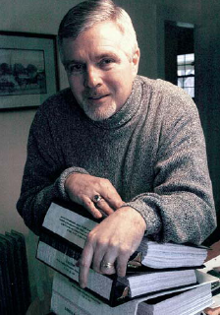
Is A Political Action Ethical?
What is the utility of engaging in the behavior?
Does the utility balance out any harm done by the action?
Does the action conform to standards of equity and justice?
E X H I B I T 14–8

Slide 30
Chapter Check-Up: Power & Politics
Write down two differences between power and leadership. Discuss with a classmate.
Do all leaders have power? Does everyone with power lead others? Discuss.

Slide 31
Chapter Check-Up: Power & Politics
When you go to work, what three things can you do to make people in your organization dependent on you? Write down your answers on a sheet of paper.
Discuss your answers with your neighbor. Do you think it’s bad to plan how you’ll get power over others?

Slide 32
Chapter Check-Up: Power & Politics
What is the difference between a power tactic and an influence tactic? Discuss with a neighbor.

